Slide 1
Soviet montage

Slide 2
Soviet cinema
In 1917, the Bolsheviks took power from Tsar Nicholas the II
The “New Soviet” Society inspired filmmakers to create film geared to the needs of the working people
Film was not an art, but a product in service of the masses
This was called Soviet Montage Cinema
Graphic and rhythmic editing provided key connections between shots
Soviet Cinema was about education-particularly the new Soviet government wanted to educate people on Marxism

Slide 3
Marxism
Examines the historical effects of capitalism on labor, productivity, and economic development, and argues that a worker revolution is needed to replace capitalism with a communist system.
The struggle between social classes—specifically between the bourgeoisie and the workers—defines economic relations in a capitalist economy and will lead inevitably to a communist revolution.
Marxist Film Theory emerged during 1920s Soviet Union
The Bolshevik revolution in 1917 was when “Marxism shaped cinema and other arts.”
In 1917, the Communist Party declared cinema vital to the arts.
Key figures of Marxist film theory
Sergei Eisenstein was one of the founding leaders of Marxist film theory.
Soviet Filmmakers wanted to move away from the Hollywood narrative structure.

Slide 4
Montage
In film theory, a montage is the assembly of various clips, strung together to create a deeper meaning.
In today’s cinema, a montage is a sequence of varying shots, edited together to make a larger narrative statement than made by any of the shots individually. Montage is an essential tool in video editing.
The early Soviet filmmakers theorized that through editing, shots could be placed in a juxtaposition to one another to create a relationship.

Slide 5
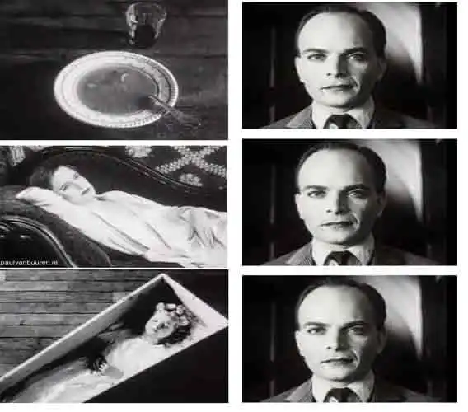
Kuleshov effect
Kuleshov found that the way you edit together a montage of different shots during post-production influences your audience’s emotional response.

Slide 6
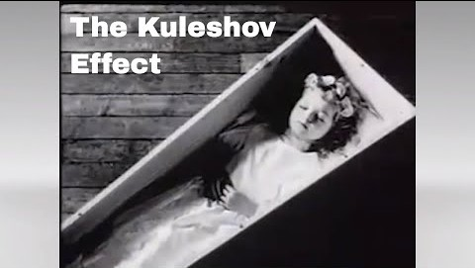
Kuleshov effect

Slide 7
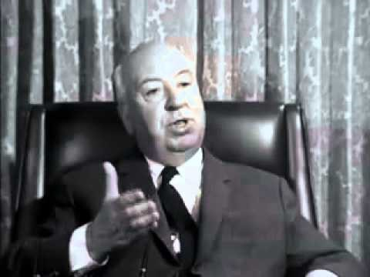

Slide 8
Sergei Eisenstein
Most noted figure of the Soviet Montage movement
Directed Battleship Potemkin, Ten Days That Shook the World, and Strike
Identified 5 types of Montage

Slide 9
5 kinds of montage
Metric: Length/Fixed Pattern
Rhythmic: Use of rhythm of shots to create a dynamic flow and enhance the emotional impact of a scene.
Tonal: Establish the tone of a scene through editing shots together that have the same thematic aim
Intellectual: Evoking of emotion through contrasting images
Over tonal: Combination of the four other types of montages: Intellectual, Metric, Rhythmic and Tonal.

Slide 10
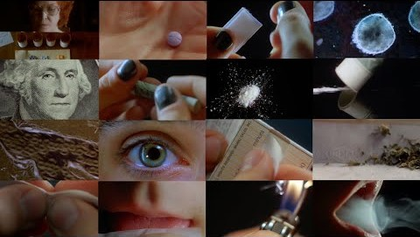
Metric Montage Requiem for a Dream(2000) Dir. Darren Aronofsky

Slide 11
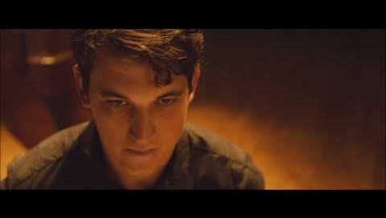
Rhythmic Montage Whiplash (2014) Dir. Damien Chazelle

Slide 12
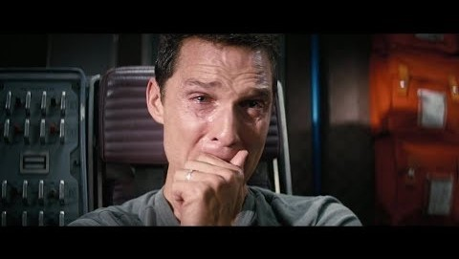
Tonal Montage Interstellar (2014) Dir. Christopher Nolan
https://youtu.be/29xvA9Ly7IQ

Slide 13
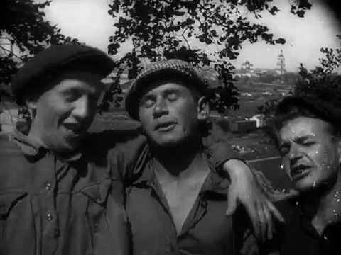
Intellectual montage strike (1925) dir. Sergei Eisenstein

Slide 14
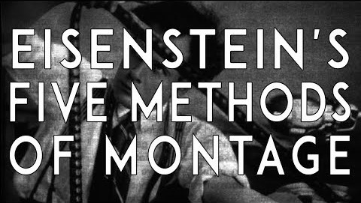
Intellectual montage

Slide 15
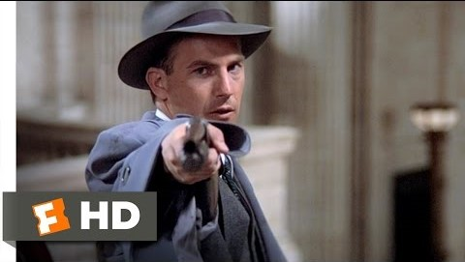
Over tonal montage Untouchables (1987) dir. Brian De Palma

Slide 16
Battleship Potemkin (1925) Dir. Sergei Eisenstein
Battleship Potemkin was a significant turning point in the Soviet Montage cinema
Commemorated the abortive 1905 revolution which has been crushed by the Tsar
Famous montage sequence: The Odessa Steps
Rhythmic, Tonal, and Intellectual Montage.

Slide 17
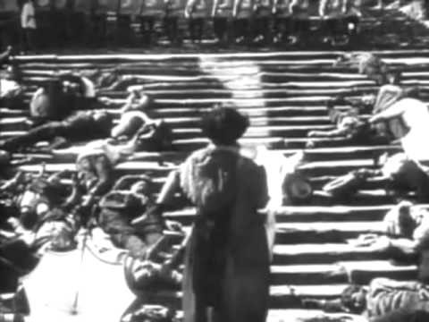
Odessa Steps

Slide 18
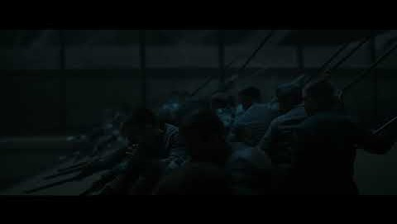
Dune (2021) Dir. Denis Villeneuve

Slide 19
Upcoming class
Read chapter 5
Reading Response Questions due next Monday, October 7th

